Slide 1
Blurred Image Enhancement Using Deep Learning Techniques
A PRESENTATION BY
D U Mugilkrishna (073)
Nikilesh Jayaguptha (081)
Niranjan B (082)

Slide 2
OBJECTIVE
This project focuses on enhancing blurred images, which often occur due to camera shake or incorrect focus, affecting applications like surveillance, photography, and medical imaging.
Using various filters and an autoencoder-based deep learning model, the project aims to reconstruct sharper images from blurred inputs.
The encoder extracts key features while reducing noise, and the decoder up-samples the data to restore image clarity.
Paired datasets of sharp and blurred images were used, and metrics like PSNR demonstrate significant improvements in visual quality, making the solution effective for real-world applications.

Slide 3
DATASET IDENTIFICATION
The dataset used is a custom collection of blurred images from Kaggle, specifically designed for image enhancement.
It includes images with varying levels of blur (motion, defocus) and diverse scenes such as landscapes, indoor settings, and urban environments.
Dataset Link:Blur Dataset
The dataset is organized into two categories:
Good Frames: High-quality, sharp images that serve as target outputs for the model.
Bad Frames: Blurred images that simulate real-world conditions and serve as input data for training, helping the model generalize well to different types of blur.

Slide 4
INFERENCE FROM THE DATASET
The dataset underwent preprocessing, with all images resized to 128x128 pixels to ensure uniformity during model training.
Each image was normalized to the range of [0, 1], helping with efficient training by maintaining consistent data distribution.
Good Frames: These sharp images serve as the reference for what the model aims to produce.
Bad Frames: These blurred images act as degraded inputs that need enhancement.
By learning from paired examples of good and bad frames, the autoencoder model is able to effectively improve the visual quality of blurred images, enhancing sharpness and clarity.
This structure enables the model to map blurry inputs to their sharp outputs, resulting in significantly improved performance in image enhancement tasks.

Slide 5
PERFORMANCE MEASURES
When evaluating image enhancement techniques, several performance metrics are used to quantify the quality of enhanced images. The three widely adopted metrics are:
PSNR (Peak Signal-to-Noise Ratio):
Measures the ratio between the maximum power of a signal (image) and the noise that affects its fidelity.
A higher PSNR value indicates better image quality, meaning the enhanced image is closer to the original.
PSNR values are expressed in decibels (dB).
A value above 30 dB usually indicates good quality, while values above 40 dB suggest excellent quality.
MSE (Mean Squared Error):
Quantifies the average squared difference between the iimages, indicating pixel-wise error.
A lower MSE value indicates that the enhanced image is closer to the original.
MSE values range from 0 to ∞, with 0 indicating no difference.
Lower MSE values reflect better image quality.

Slide 6
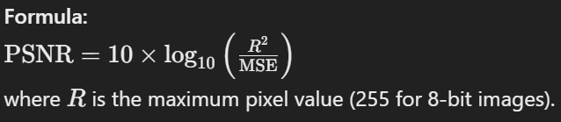
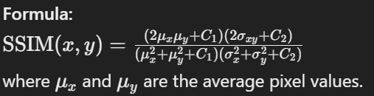
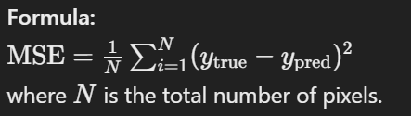
SSIM (Structural Similarity Index):
A perceptual metric that compares luminance, contrast, and structure between original and enhanced images, considering human visual perception.
SSIM values range from -1 to 1, with 1 indicating perfect similarity.
Values above 0.85 are considered high structural similarity, indicating good quality.

Slide 7
SHARPENING FILTER
Definition:
Enhances edges and fine details in an image by increasing the contrast between neighboring pixels.
Works by amplifying differences in pixel intensity around edges, making objects appear clearer.
Edge Detection:
Highlights areas of rapid intensity change, making the image sharper and often used to emphasize object boundaries, textures, and small details.
Uses the second derivative to detect and enhance edges.
Works particularly well for isotropic edge detection, where the filter responds equally to all orientations.
Applications:
Commonly used to sharpen blurry photos, enhance medical scans (like X-rays and MRIs), and improve video clarity in security footage.
Helps in improving focus and structure in images for applications like optical character recognition (OCR) or machine vision.

Slide 8
UNSHARP MASKING FUNCTION
Definition:
A sharpening technique that enhances edges by selectively amplifying contrast, resulting in sharper, more defined images. This method improves the visual clarity of fine details and edges without drastically altering the entire image.
Process:
Blurring (Gaussian Blur): The image is blurred using a Gaussian blur to smooth out high-frequency details and retain broader structures.
Subtraction: The blurred image is subtracted from the original, generating an edge mask that isolates high-contrast areas (edges).
Recombination: The edge mask is added back to the original image, sharpening edges while keeping non-edge areas unaffected.
Applications:
Widely used in photo editing and printing for fine-tuning sharpness without introducing noise or artifacts.

Slide 9
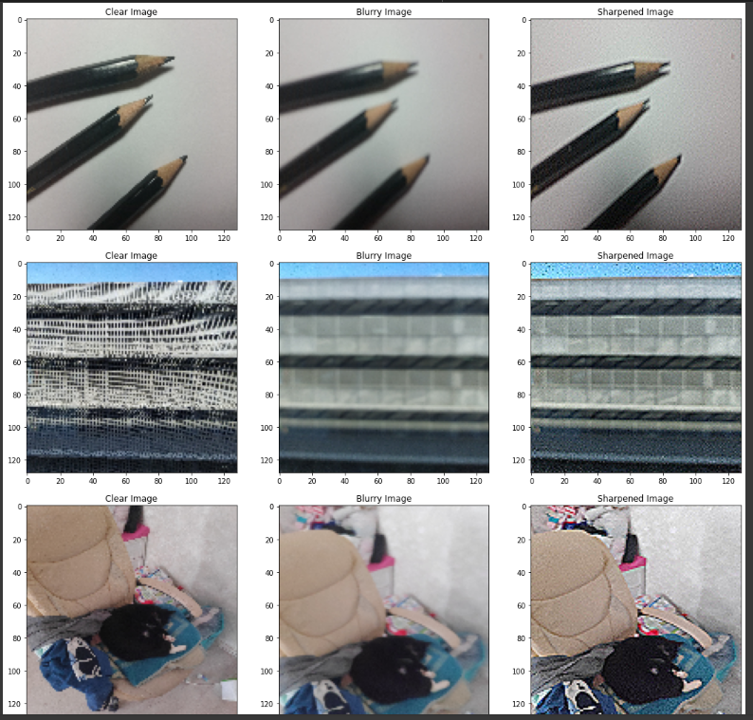
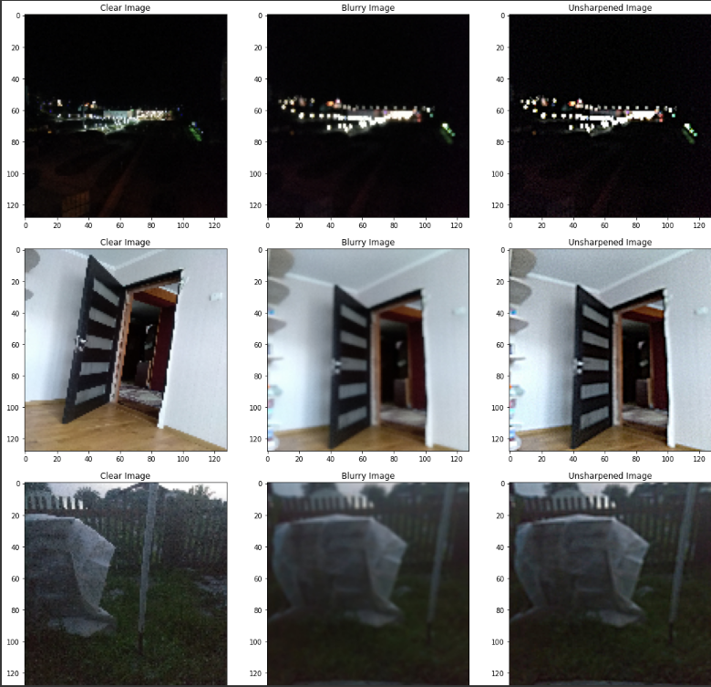
OUTPUT WITH THE FILTERS

Slide 10
ANALYSIS OF THE RESULT - SHARPENING FILTER
PSNR:
Blurred Images: PSNR values typically range from 12.66 dB to 19.52 dB, indicating varying levels of noise and distortion.
Unblurred Images: PSNR values range from 11.61 dB to 18.17 dB after sharpening. Observation: A slight decrease in PSNR after sharpening, suggesting a minor reduction in image quality due to increased noise.
MSE:
Blurred Images: MSE values generally range from 0.0094 to 0.0543, reflecting substantial pixel-wise discrepancies.
Unblurred Images: MSE values increase to a range of 0.0152 to 0.0690 after sharpening. Observation: An increase in MSE after sharpening indicates less accurate pixel-level predictions.
SSIM:
Blurred Images: SSIM values range from 0.4670 to 0.8943, suggesting low to moderate structural similarity.
Unblurred Images: SSIM values decrease to a range of 0.4047 to 0.8624 post-processing. Observation: The decrease in SSIM indicates reduced structural similarity, likely due to noise introduced during the sharpening process.

Slide 11
ANALYSIS OF THE RESULT - UNSHARP MASKING
PSNR:
Blurred Images: PSNR values typically range from 11.35 dB to 20.27 dB, indicating varying levels of noise and distortion.
Unblurred Images: PSNR values range from 11.01 dB to 18.70 dB after unsharp masking. Observation: A slight decrease in PSNR after unsharp masking, suggesting potential degradation in image quality.
MSE:
Blurred Images: MSE values generally range from 0.0094 to 0.0732, reflecting significant pixel-wise discrepancies.
Unblurred Images: MSE values increase to a range of 0.0135 to 0.0792 after processing. Observation: An increase in MSE indicates reduced accuracy in pixel-level predictions following sharpening.
SSIM:
Blurred Images: SSIM values range from 0.5361 to 0.6720, suggesting low to moderate structural similarity.
Unblurred Images: SSIM values decrease to a range of 0.5219 to 0.5848 post-processing. Observation: The slight decrease in SSIM indicates some loss of structural similarity and clarity due to unsharp masking.

Slide 12
THE NEED FOR THE AUTOENCODER MODEL
Limitations of Simple Filters
Traditional image enhancement methods, such as sharpening filters and unsharp masking, often fail to deliver satisfactory results in restoring blurred images.
Simple filters primarily focus on enhancing edges but can overlook finer details, leading to artifacts and unnatural appearances.
These methods may inadvertently amplify noise in images, resulting in degraded quality rather than improvement.
Poor Metric Performance:
PSNR values often reflect high noise levels, typically ranging from 11.01 dB to 20.27 dB.
MSE values indicate significant discrepancies, with ranges like 0.0094 to 0.0792.
SSIM values suggest low structural similarity, often ranging from 0.5219 to 0.6720.
Need for Deep Learning:
Autoencoders offer a robust solution by leveraging deep learning techniques to learn complex patterns and representations in images. Unlike traditional methods, autoencoders can reconstruct images with improved clarity, capturing essential features that simple filters may miss.
Autoencoders adjust to various types of blur and noise, enabling them to provide tailored enhancements for different scenarios.
By significantly improving PSNR, MSE, and SSIM metrics, autoencoders deliver superior image restoration, making them ideal for applications requiring high fidelity, such as medical imaging and professional photography.

Slide 13
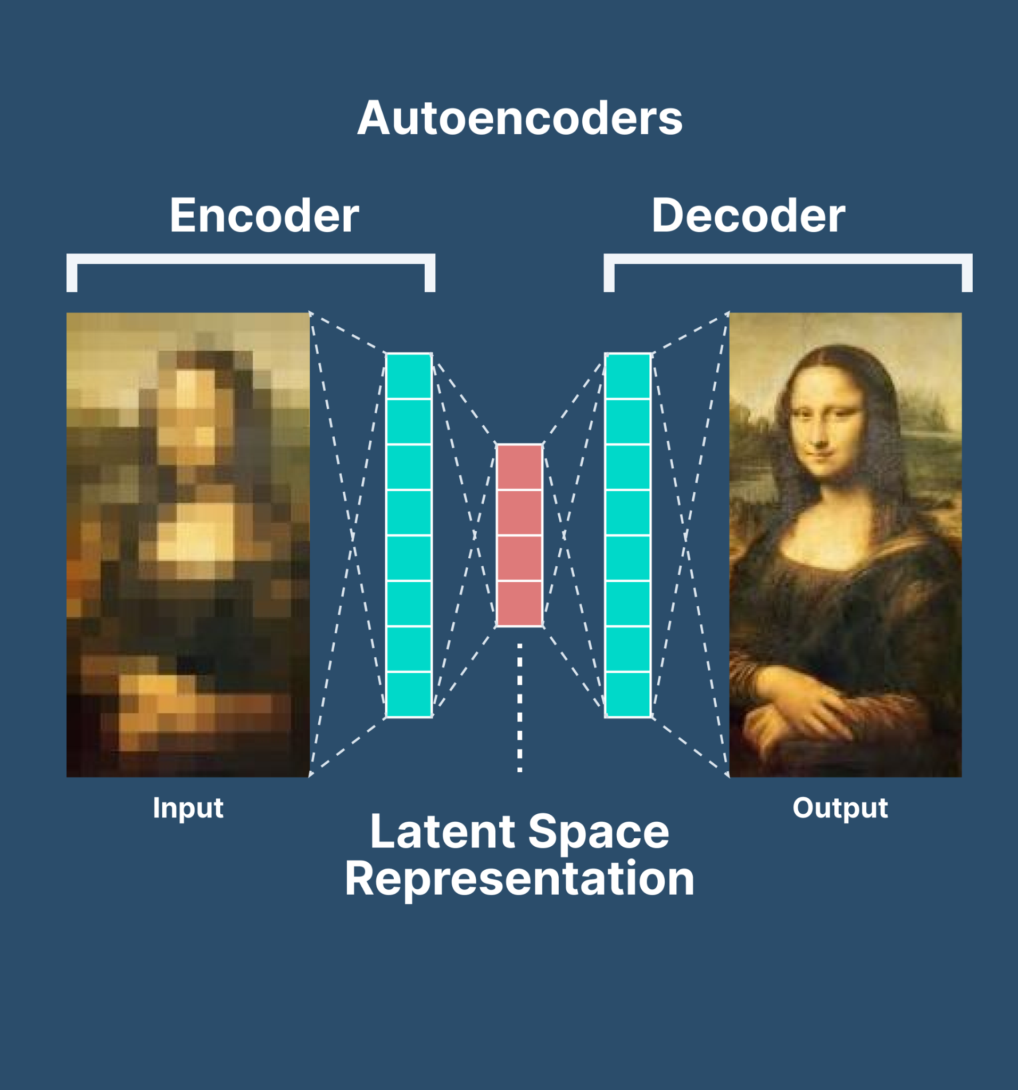
DEEP LEARNING MODEL - AUTOENCODER
Autoencoder-based Enhancement:
An autoencoder model was used to enhance blurred images.
This unsupervised deep learning model learns to compress (via an encoder) and reconstruct (via a decoder) images, making it ideal for improving image quality by learning compact representations and reconstructing sharp versions.
Encoder:
The encoder uses convolutional layers to extract features from the input image.
Each layer, followed by ReLU activation, reduces spatial dimensions while detecting edges, textures, and structures that enhance image quality.

Slide 14
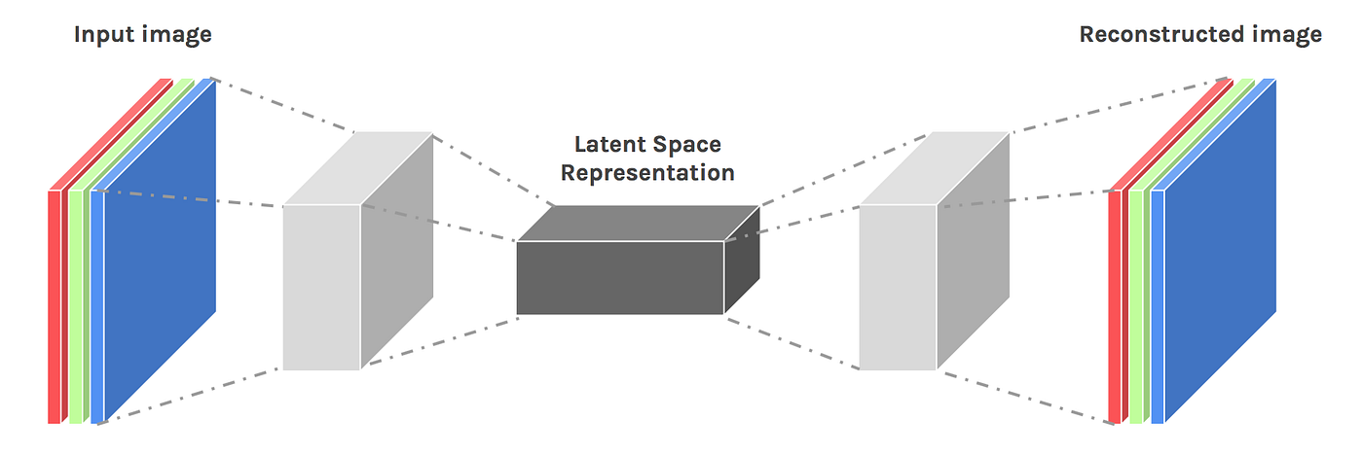
Decoder:
The decoder reconstructs the image using transposed convolutional layers, up-sampling the data to the original resolution.
The goal is to generate a sharp image similar to the original reference.
Network Parameters:
Input Shape: 128x128 RGB images
Batch Size: 32
Latent Dimension: 256, representing compressed image information
Number of Filters: [64, 128, 256] for encoding, reversed for decoding

Slide 15
PREPROCESSING AND MODEL STRUCTURE
Preprocessing Steps
Normalization: Images were normalized to a [0, 1] range by dividing pixel values by 255, ensuring consistency and enabling the model to learn effectively.
Resizing: All images were resized to 128x128 pixels to maintain uniformity and reduce computational load, making training more efficient.
Model Architecture
Encoder: Uses three convolutional layers, each followed by ReLU activation, to downsample the image while extracting key features crucial for reconstructing sharper versions.
Decoder: Transposed convolutional layers upsample latent features, increasing spatial dimensions to reconstruct sharper images. The final layer outputs images of the same dimension but with enhanced quality.

Slide 16
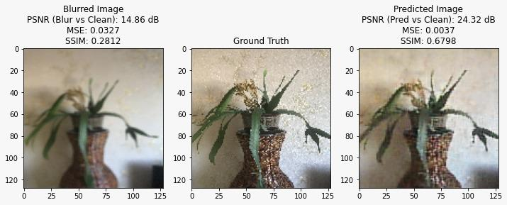
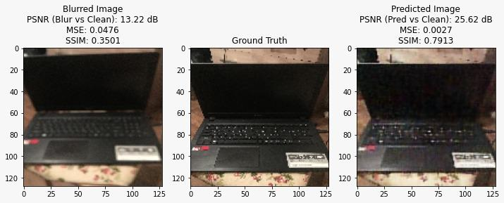
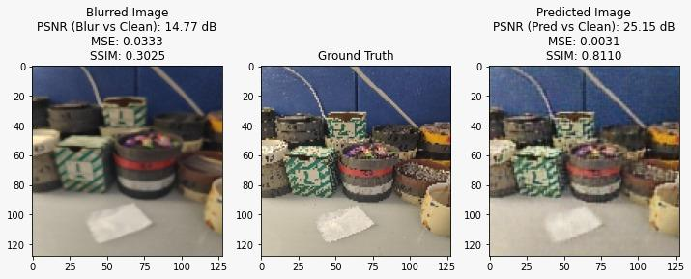
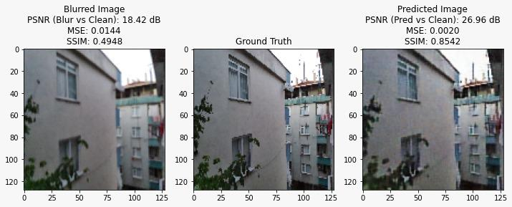
OUTPUT WITH THE AUTOENCODER MODEL

Slide 17
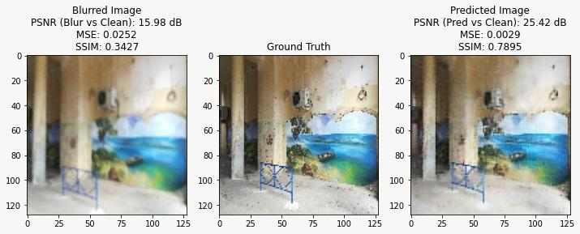
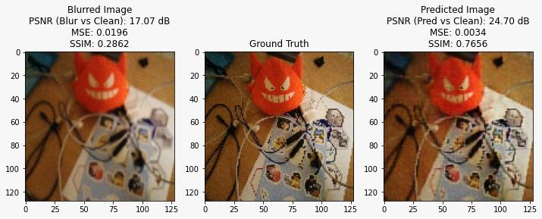
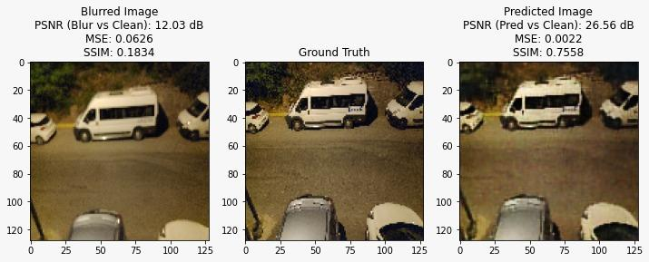

Slide 18
ANALYSIS OF THE RESULT - AUTOENCODER MODEL
The model demonstrates significant improvements in restoring blurred images based on key metrics:
PSNR:
Initial PSNR values for blurred images: 12-18 dB (high noise and distortion).
After restoration: 24-26 dB, indicating a reduction in noise.
Improvement of approximately 7-14 dB, showing enhanced quality closer to the original.
MSE:
Initial MSE values: 0.0196 to 0.0626, reflecting large pixel-wise discrepancies.
After restoration: MSE dropped to 0.0020-0.0037, indicating accurate pixel-level predictions.
This sharp decrease demonstrates the model's ability to produce nearly indistinguishable images from the ground truth.
SSIM:
Initial SSIM values: 0.1834 to 0.4948, indicating low structural similarity.
After processing: SSIM improved to 0.6798 to 0.8542, suggesting significant recovery of structural information.
This marked increase indicates that predicted images preserve essential structural aspects, resulting in a more realistic restoration.

Slide 19
CONCLUSION
The proposed autoencoder model effectively enhances blurred images through advanced deep learning techniques. The encoder captures essential features, while the decoder reconstructs images with improved sharpness and quality, excelling in noise reduction and feature preservation.
While traditional filters, such as sharpening filters and unsharp masking, provide some level of enhancement, they often fall short in recovering fine details and may introduce artifacts or amplify noise. In contrast, the autoencoder demonstrates superior performance in various metrics:
PSNR: Higher values indicate substantial visual quality improvements compared to traditional methods.
MSE: Minimized values reflect better pixel accuracy, showcasing the model's capability to produce nearly indistinguishable images from the original.
SSIM: Enhanced SSIM values demonstrate the effectiveness of the autoencoder in preserving structural features like edges and textures, leading to more realistic image restoration.
This project illustrates the autoencoder’s capability to enhance blurred images effectively, making the results applicable in high-fidelity scenarios such as photography, surveillance, and medical imaging, where clarity is crucial. The model’s simplicity and ability to learn essential details ensure a significant improvement in overall visual quality compared to conventional filtering techniques.

